Slide 1
Modifying an Ethernet asset
BT Wholesale Online
V2
LEGAL NOTICE: The information contained in this briefing is confidential information as per your terms and conditions with BT. Please do not forward, republish or permit unauthorised access. The content is accurate at the time of writing and is subject to change.

Slide 2
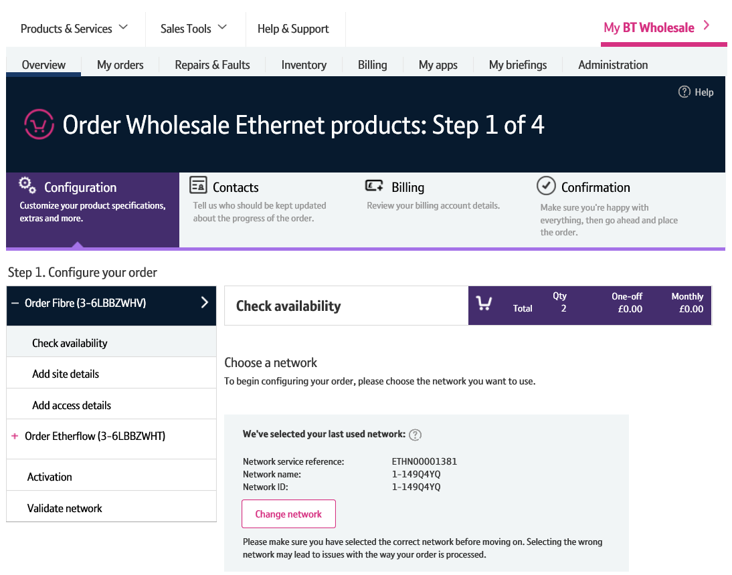
Contents
What’s in this User Guide?
p4 - Pre-requisites
p5 – Introduction
p6 – Layout
p7 – What can I modify?
p8 – How do I modify an asset?
p9 – Searching for an asset
p11 – Initiate the modify order
p12 – Making your changes
p18 – Discard changes

Slide 3
Version Control
Date | Change | Version
16/01/17 | User Guide Published. | 1
30/04/18 | Re-branded | 2

Slide 4
Pre-Requisites
What do you need to enter an Ethernet order via the new journey?
You need correct access and privileges, including Business zone. If you don’t have this, please contact your company administrator to action.
Please visit our Transformed Ethernet Ordering page to learn about what order journeys are available.
You must be using a Windows machine and using the latest version of Internet Explorer, Chrome or Firefox
Mobile devices, Mac and Safari are not supported

Slide 5
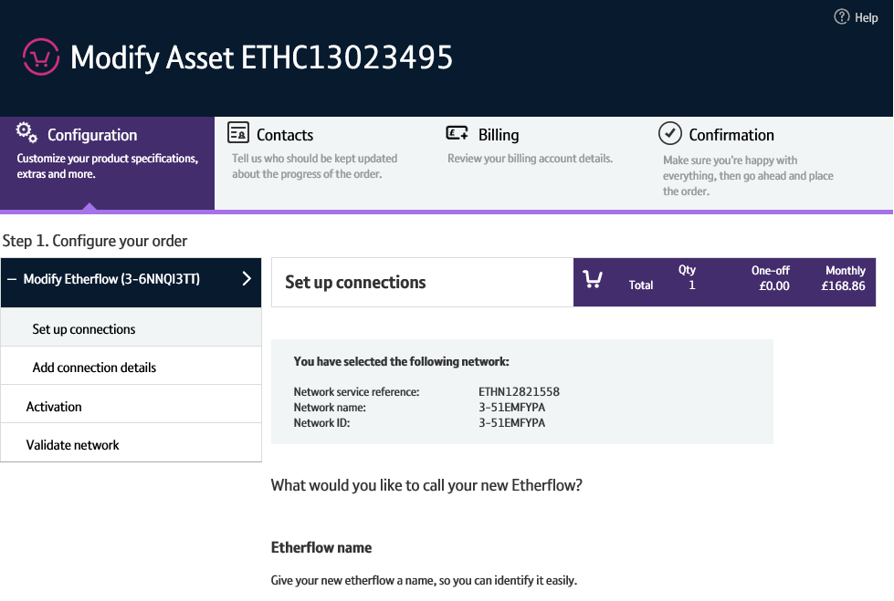
Introduction
We’ve replaced the current Eco Plus modify order journey with a new improved modify order journey for Ethernet.
Accessed via Business Zone, the new journey will allow you to make it easier to:
Modify details of an asset
The new journey has improved navigation and layout, is compatible with modern browsers and easier to use than Eco Plus.

Slide 6
Layout
1. Navigation menu
The left hand menu tells you the steps you’re going to take when modifying your asset.
2. Order configuration
To modify your asset, simply make the changes then submit the order.
Note: some items can’t be modified. They will be greyed out and read-only.
3. Discard changes
The ‘Discard changes’ button allows you to reset any changes you’ve made prior to submitting the modify order.
1
2
3

Slide 7
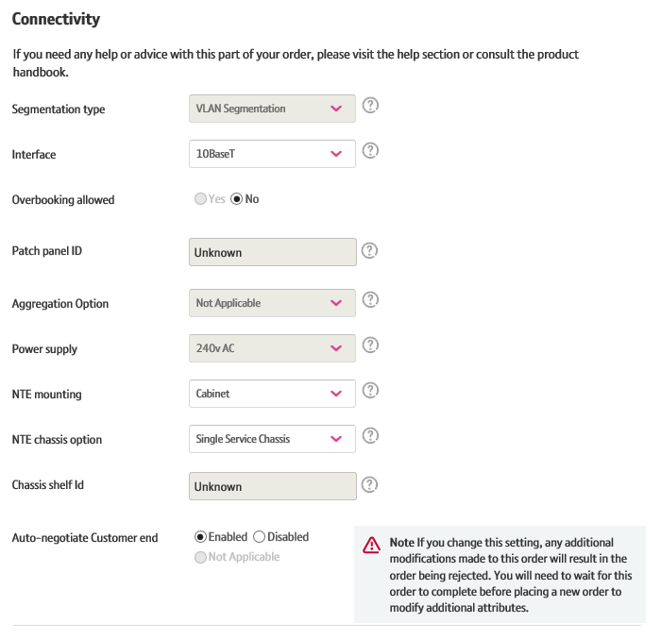
What can I modify?
Attributes you can modify
Although not an exhaustive list, the following attributes can be modified on an Etherflow
Bandwidth
Resilience
Access Pricing Period
Contact details
Notes
Site and Access details
Attributes you can’t modify
For Etherway Fibre, as your order progresses some attributes will become un-modifyable. These include:
Segmentation type
Service point details (Room, Floor and Location)
Bandwidth
Resilience
Access pricing period
Connectivity details such as Interface Type, Power Supply NTE Chassis and mounting Options
For a complete list of what can and can’t be modified, see the product handbook.

Slide 8
How do I modify an asset?
There’s a number of steps that need to be performed in order for you to modify your asset:
Search for your asset
First you’ll need to search for your asset on Business Zone. From here, you can instigate the modify.
Check to see if your order can be modified
We’ll then need to check that your order can be modified. You won’t be able to modify an asset if there’s any open orders or faults associate with it. If your asset can’t be modified, we’ll tell you.
Make your changes
You’ll then make the changes you require within the order journey. Any attributes that can’t be amended will be inaccessible and greyed out or read only.
Submit the modify order
Once you’ve made your changes, you’ll need to submit them in the same way you placed your original order.

Slide 9
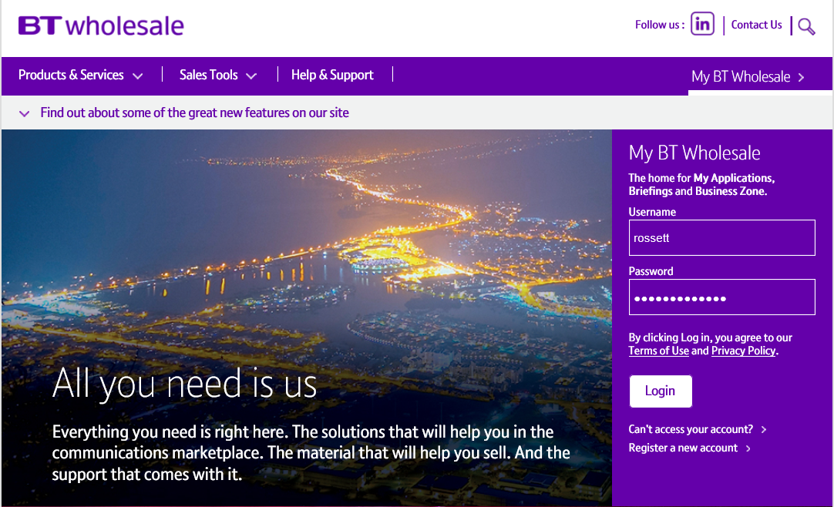
Searching for an asset
Step 1: Logging In
Go to www.btwholesale.com
Enter your Username and Password
Click ‘Login’

Slide 10
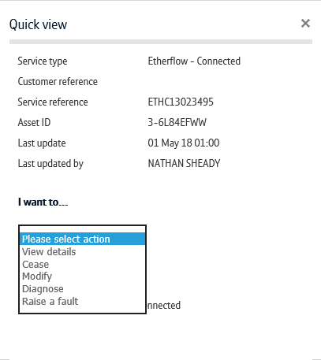
Searching for an asset
Step 2: Searching
There’s a lot of different ways you can search for an asset in Business Zone. The easiest way is by entering your service reference in the search bar.
Clicking ‘View Details’ will take to directly into the View Asset journey. There’s a ‘Modify’ option here.
Alternatively, click on the reference number to see the inventory quick view
From the quickview, click ‘Modify’ in the actions dropdown.
You can also find the asset by using the filters on the Inventory section of the Overview page and on the Inventory page. Please see the Business Zone guide for more details.
2
1
3

Slide 11
Initiate the modify order
Once the modify order has been initiated, a check will be carried out to see if the asset can be modified.
If the asset can’t be modified, you’ll be taken to the ‘View Asset’ screen.
Here, you’ll be told will be told why the asset can’t be modified.

Slide 12
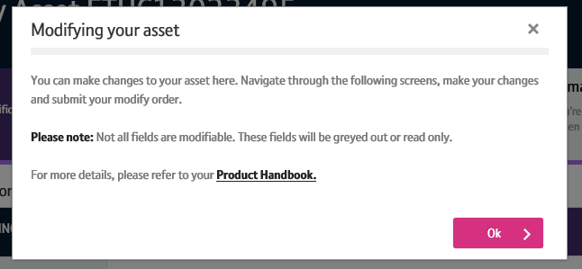
Making your changes
Once the modify has been initiated, you’ll receive a notification telling you that you might experience an outage when the modify is activated.
If you’re happy accepting the outage,
If you’re happy accepting the outage, click ‘Continue’ to proceed.
You’ll then be given instructions on how to modify your service. Click ‘Ok’ to continue.
1
2

Slide 13
Making your changes
You’ll now see the ‘Modify order’ screen
From here, you’ll navigate through the order journey, making your changes and submitting the modify order.

Slide 14
Making your changes
Attributes that can’t be modified will be greyed out or read only.

Slide 15
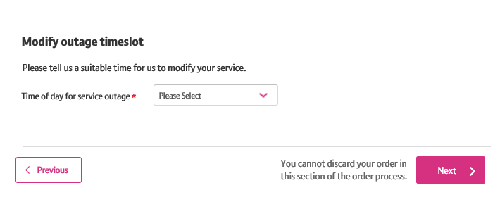
Making your changes
Within the modify journey, you’ll be asked what time you’ll accept an outage for us to make the changes.

Slide 16
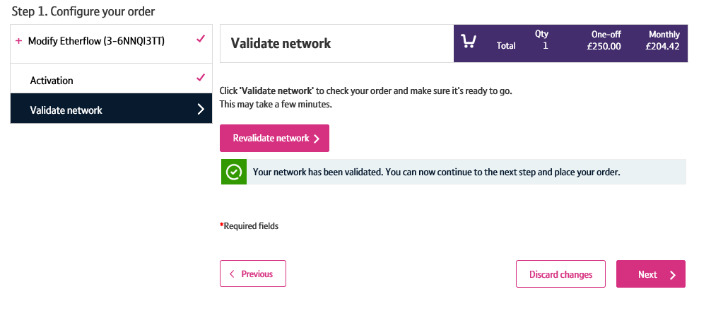
Making your changes
Once you’ve made your changes, you’ll need to validate them.
This will check that the changes you have made are compatible with the service you’ve ordered.

Slide 17
Making your changes
Once your changes have been validated, you’ll need to proceed to the ‘Confirmation’ step.
Once you’re happy with the changes you’ve made, click ‘Place Order’.
Your modify order will now be submitted and reflected when viewing your order.
1

Slide 18
Discarding changes
If you want to reset the amendments you’ve made prior to placing your amend order, you can do so by clicking the ‘Discard Changes’ button.
You’ll then need to confirm you wish to cancel the changes you’ve made by clicking ‘Yes, discard changes’.
Any changes you’ve made will be reset and you’ll be returned to the ‘View Order’ screen.
Note: You can’t discard changes on either the Add Access screen for Etherway or the Add Connection Details screen for Etherflow.
1
2

